Slide 1
Introduction to Ansible
By- Somarko Das

Slide 2
Introduction to Ansible
Ansible is a radically simple IT automation platform that makes your applications and systems easier to deploy.
It support configuration management with examples as below.
Configuration of servers
Application deployment
Continuous testing of already install application
Provisioning
Orchestration
Automation of tasks

Slide 3
Why Ansible
It is a free open source application
Agent-less – No need for agent installation and management
Phython/yaml based
Highly flexible and configuration management of systems.
Large number of ready to use modules for system management
Custom modules can be added if needed
Configuration roll-back in case of error
Simple and human readable
Self documenting

Slide 4
INSTALL ANSIBLE
Install ansible on a RHEL/CentOS Linux based system
Type the following yum command:
$ sudo yum install ansible
Install ansible on a Debian/Ubuntu Linux based system
Type the following apt-get command:
$ sudo apt-get install software-properties-common
$ sudo apt-add-repository ppa:ansible/ansible
$ sudo apt-get update
$ sudo apt-get install ansible
Note: Python SHOULD be Installed

Slide 5
Create the RSA Key Pair
The first step is to create the key pair on the Server machine
ssh-keygen –t rsa
Once you have entered the Gen Key command, you will get a few more questions:
Enter file in which to save the key (/home/test/.ssh/id_rsa):
Enter no password for the next prompt
Copy the Public Key
ssh-copy-id test@192.168.85.135
Repeat the same process for other machines you wish to login automatically with.
Ensure the test username has sudo access to the remote clients

Slide 6
What is Module
Modules
Modules are bits of code transferred to the target system and executed to satisfy the task declaration. Ansible ships with several hundred today!
apt/yum
copy
file
get_url
git
ping
debug
service
Synchronize
Modules Documentation
http://docs.ansible.com/

Slide 7
Whats Inventory
Inventory
Inventory is a collection of hosts (nodes) with associated data and groupings
that Ansible can connect and manage.
Hosts (nodes)
Groups
Inventory-specific data (variables)
Static or dynamic sources
Hybrid

Slide 8
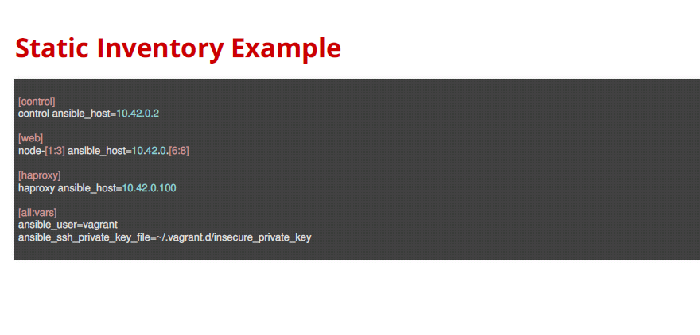

Slide 9
Configuration of ansible Inventory
Do the following on the Server machine
Create the list of client machines you wish to access via this server
vi /etc/ansible/hosts ( And enter the following lines and save file)
[Servers]
192.168.85.135
192.168.85.136
Run the ping command below to see if indeed you are reaching both client nodes
ansible -m ping all

Slide 10
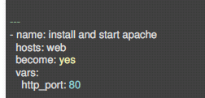
Variables
Ansible can work with metadata from various sources and manage their context in the form of variables.
Plays and tasks
Files
Inventory
Discovered facts
Roles
In Plays and tasks

Slide 11
Include vars file
- name: Include vars of stuff.yaml into the 'stuff' variable (2.2).
include_vars:
file: stuff.yaml
name: stuff
=======================================================
- name: Bare include (free-form)
include_vars: myvars.yaml

Slide 12
Vars in Inventory

Slide 13
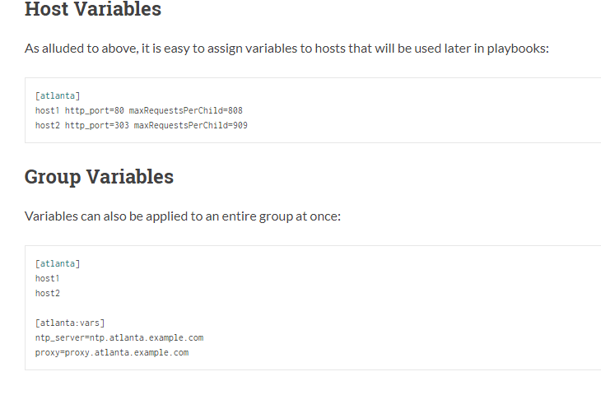

Slide 14
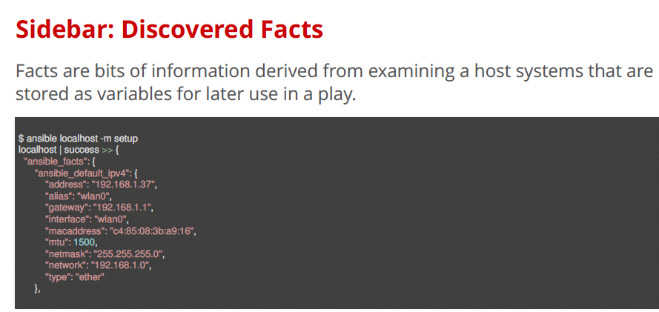

Slide 15
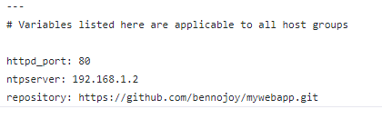
During Execution
ansible-playbook binlogs.yml --extra-vars "env=database01“
In Var Files / Roles

Slide 16
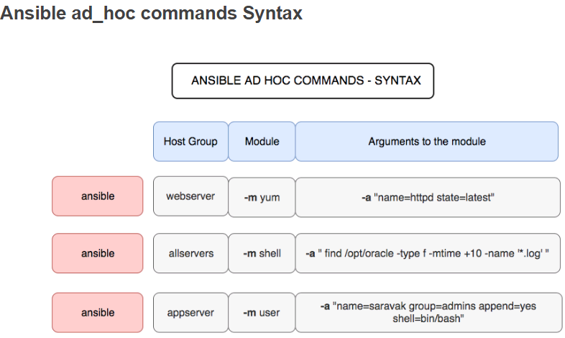

Slide 17
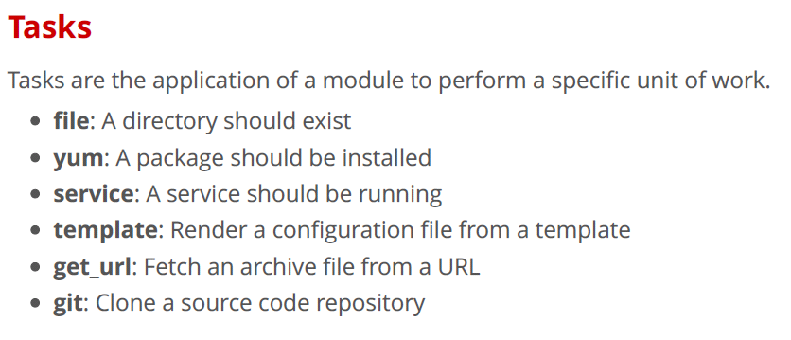

Slide 18
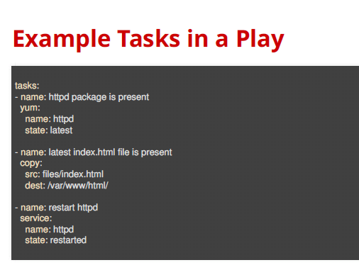

Slide 19
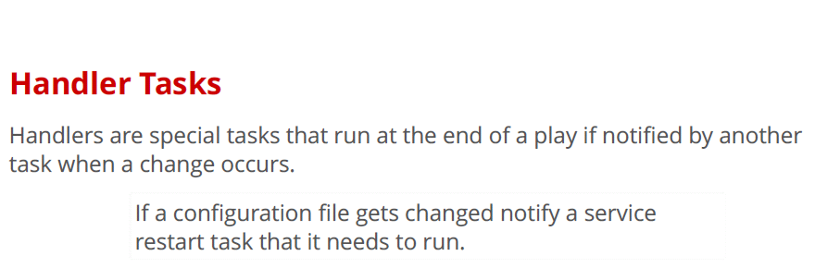

Slide 20
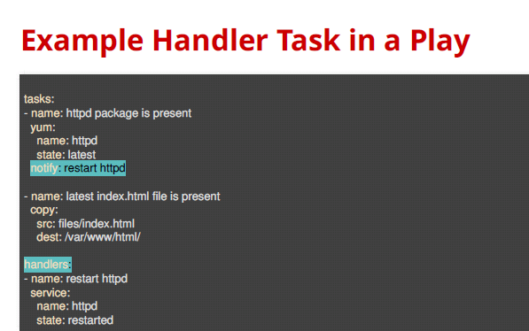

Slide 21
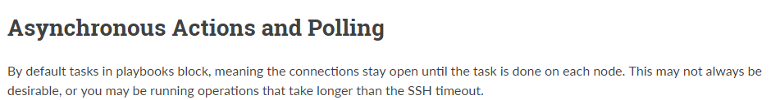
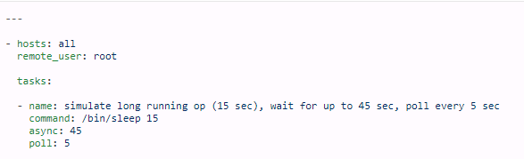

Slide 22
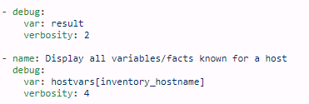
debug – Print statements during execution
- debug:
msg: “Hi How are you"

Slide 23
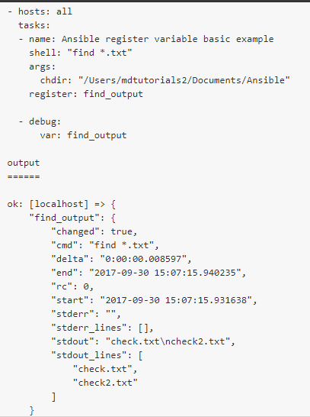
Register a Variable

Slide 24
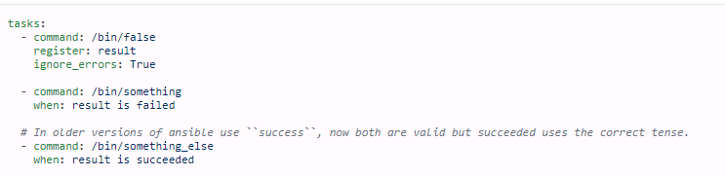
Conditionals-When
- shell: /usr/bin/bar
when: foo_result.rc == 5

Slide 25
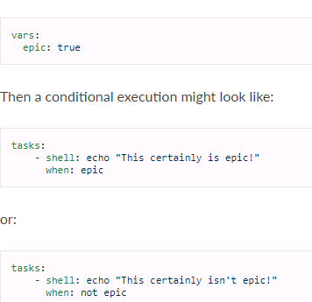

Slide 26
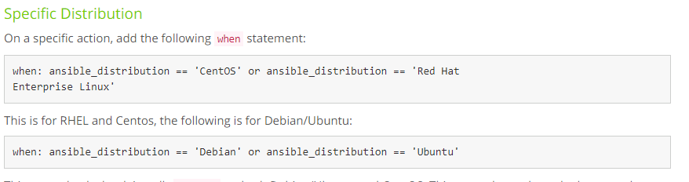

Slide 27
Loops – With_items
- name: add several users
user:
name: "{{ item.name }}"
state: present
groups: "{{ item.groups }}"
with_items:
- { name: 'testuser1', groups: 'wheel' }
- { name: 'testuser2', groups: 'root‘ }
For example: for copying multiple files
- { src: ‘@src1’, dest: ‘@Dest1' }
- { src: ‘@src2’, dest: ‘@Dest2' }
- name: add several users
user:
name: "{{ item }}"
state: present
groups: "wheel"
with_items:
- testuser1
- testuser2

Slide 28
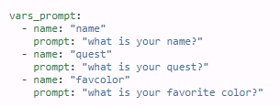
Prompt Module

Slide 29
Delegation of a task to specific host
- name: add back to load balancer pool
command: /usr/bin/add_back_to_pool {{ inventory_hostname }}
delegate_to: 127.0.0.1

Slide 30
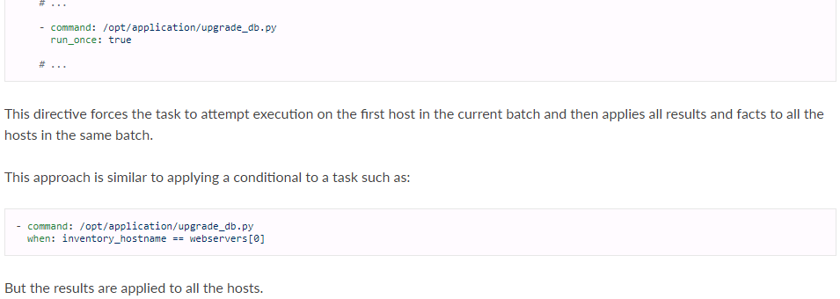
Run Once

Slide 31


Error Handling
- hosts: webservers
max_fail_percentage: 30

Slide 32
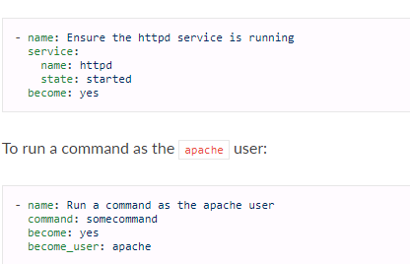
Privilege Escalation

Slide 33
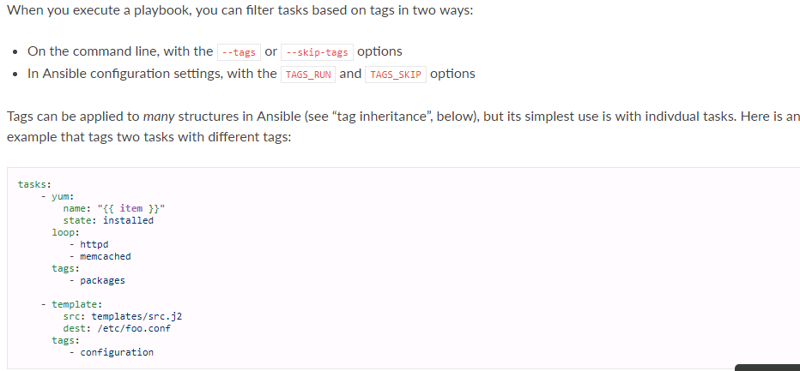
Ansible Tags

Slide 34
Ansible Dry Run
ansible-playbook --syntax-check site.yml
# Dry Run
ansible-playbook foo.yml --check

Slide 35
Ansible Vault
ansible-vault create foo.yml
Note: First you will be prompted for a password. The password used with vault currently must be
the same for all files you wish to use together at the same time.
ansible-vault edit foo.yml
ansible-vault decrypt foo.yml bar.yml baz.yml
ansible-vault view foo.yml bar.yml baz.yml

Slide 36
Modules

Slide 37
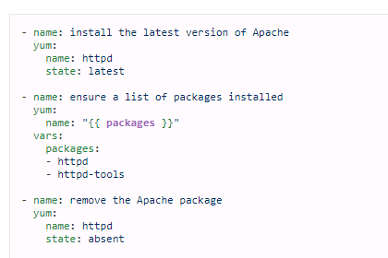
Yum

Slide 38
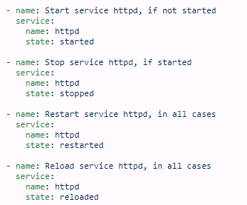
Service Module

Slide 39
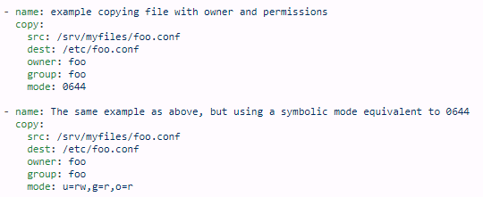
Copy Module

Slide 40
Command
- name: return motd to registered var
command: cat /etc/motd
register: mymotd
raw
- name: Bootstrap a host without python2 installed
raw: dnf install -y python2 python2-dnf libselinux-python
Shell
- name: Execute the command in remote shell; stdout goes to the specified file on the remote.
shell: somescript.sh >> somelog.txt

Slide 41
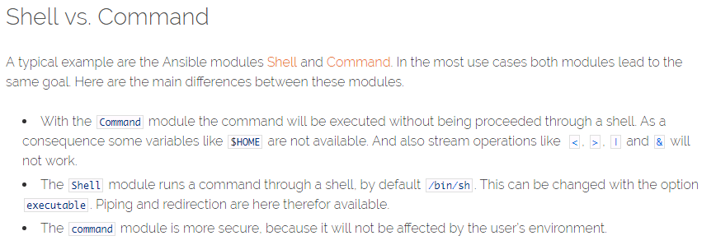
Raw is used in case of routers mainly

Slide 42
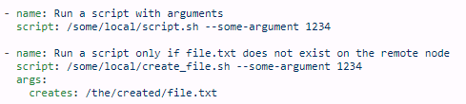
Script

Slide 43
Cron
- name: Ensure a job that runs at 2 and 5 exists. Creates an entry like "0 5,2 * *
cron:
name: "check dirs"
minute: "0"
hour: "5,2"
job: "/some/job.sh"

Slide 44
Set_Fact
- set_fact:
one_fact: something
other_fact: "{{ local_var * 2 }}“
This is a fixed variable and wont change and also is declared during tasks

Slide 45
Firewall
- firewalld:
service: https
permanent: yes
state: enabled

